Slide 1

BHARATI VIDYAPEETH’S COLLEGE OF ENGINEERING FOR WOMEN,PUNE-43
Project Selection Presentation
Design and Development of an EMG Controlled Prosthetic Arm
-Presented by
Niharika Naik
Saniya Mulla
Mohini Mane
BE-II (Electronics &Telecommunication Engg. )
Academic year: 2024-25
BVCOEW Pune .
-Under the guidance of
Prof. A . P . Yadav
Electronics &Telecommunication Engg.
BVCOEW Pune
Design and Development of an EMG Controlled Prosthetic Arm

Slide 2
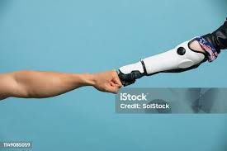
OUTLINE
Introduction
Literature survey
Problem statement
Objectives
Block diagram
Advantages
Design and Development of an EMG Controlled Prosthetic Arm
Notes:
BE-II (ENTC) BVCOEW,Pune-43

Slide 3

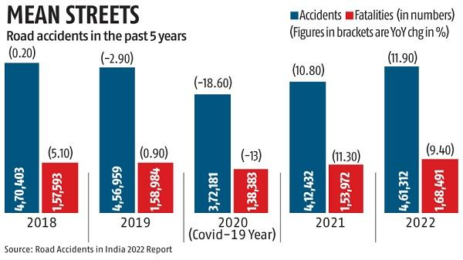
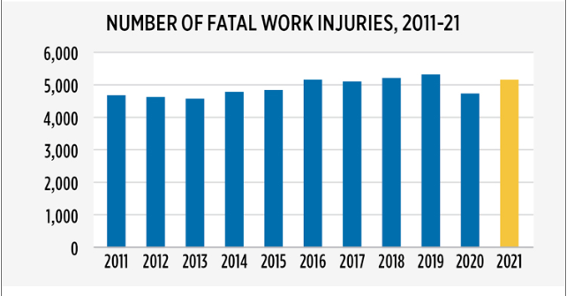
INTRODUCTION
> 4000 people get injured in road accident every day and live without one or more body parts.
Dependency on imported expensive prosthestic.
Our goal of these project is To provide an affordable Solution for prostetic limb for our country
Design and Development of an EMG Controlled Prosthetic Arm

Slide 4
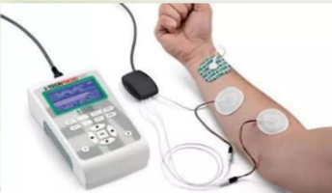
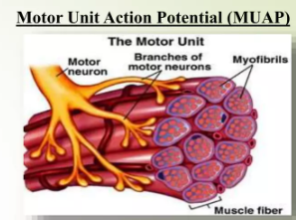
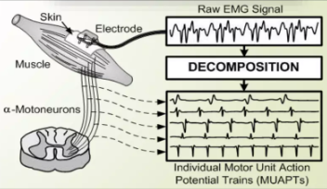
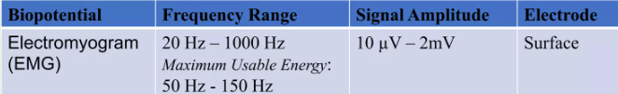
EMG-Electromyography
Electromyography (EMG) detects electrical potential generated by muscle cells upon voluntary contraction of muscle.
Brain commands in spfgal cord transmitted to muscle fiber by Motor neuron.
When motor unit is activated, muscle fibers contract.
Design and Development of an EMG Controlled Prosthetic Arm

Slide 5
LITERATURE SURVEY
Sr No | Name of author | Paper Title/Reference | Publication | Approach & concept about paper | Advantages | Limitations
1 | Si-Hwan Heo and Hyung-Soon Park | Proximity Perception-Based Grasping Intelligence: Toward the Seamless Control of a Dexterous Prosthetic Hand | IEEE/ASME TRANSACTIONS ON MECHATRONICS, VOL. 29, NO. 3, JUNE 2024 | Real-time, personalized, high-performance prosthetic control. | High performance, real-time decision-making, personalization. | Complex Hardware requirements
2 | Nitish V. Thakor Ehsan Rahiminejad | A Biomimetic Circuit for Electronic Skin With Application in Hand Prosthesis | IEEE TRANSACTIONS ON NEURAL SYSTEMS AND REHABILITATION ENGINEERING, VOL. 29, 2021 | Biomimetic circuit for tactile afferents. Replicating biological spiking patterns for sensory feedback. | Biological Accuracy,Compact Size,High Sensory Resolution,Receptive Field Complexity | Complex Structure Expensive
These are some
Design and Development of an EMG Controlled Prosthetic Arm

Slide 6
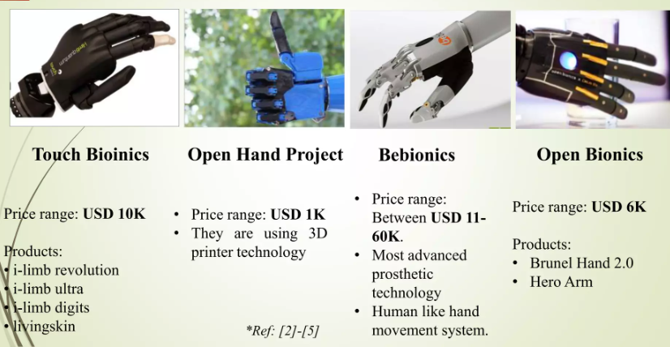
BE-II (ENTC) BVCOEW,Pune-43
These are some products like my project
Design and Development of an EMG Controlled Prosthetic Arm

Slide 7
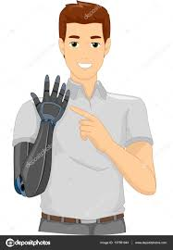
BE-II (ENTC) BVCOEW,Pune-43
PROBLEM STATEMENT
To Design and develop an EMG-controlled prosthetic arm system capable of intuitive and precise movement control through muscle contraction, addressing the need for advanced functionality and user-friendly integration in prosthetic technology.
OBJECTIVES
To Design an Analog Frontend circuit to record the electrical activity of muscle (EMG).
To Design and 3D print a prosthetic arm.
To Detect muscle contraction to generate a command signal to control prosthetic arm.
Design and Development of an EMG Controlled Prosthetic Arm

Slide 8
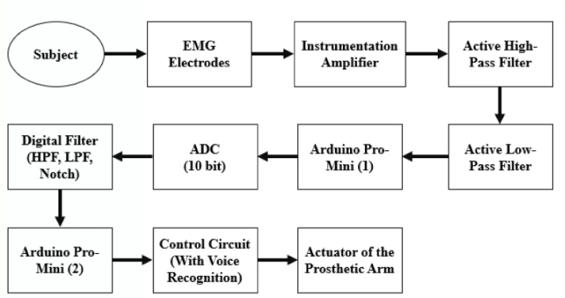
BLOCK DIAGRAM
Design and Development of an EMG Controlled Prosthetic Arm

Slide 9

Advantages :
1. Intuitive Control: Enables natural control of the prosthetic arm through muscle contractions, improving user experience and ease of operation.
2. Enhanced Functionality: Offers precise movement capabilities, allowing users to perform a variety of tasks with accuracy and efficiency.
3. Improved Quality of Life: Enhances independence and daily living activities for individuals with limb loss or limb difference.
4. Personalized Adaptation:Supports individualized tuning and customization to match each user's specific movement characteristics and preferences.
5. Technological Integration: Integrates advanced EMG signal processing and prosthetic arm design, leveraging modern technologies for seamless operation and performance.
Design and Development of an EMG Controlled Prosthetic Arm

Slide 10

Design and Development of an EMG Controlled Prosthetic Arm

